Slide 1
Data Safety Analysis
Key Concepts
5th February 2024
Dr. Divya Atkins
divya@mca-ltd.com

Slide 2


Background
Data is distinct from software
SCSC DSIWG: Data Safety Initiative Working Group, set up 2012
  To formulate best practice
  Members: Industry and academia
DSG: Data Safety Guidance, now Version 3.7
  Industry Agnostic
  Adopted by NHS as clinical best practice
MCA-Ltd promoting tool support for DSG
    Demonstrator
    Prototype for User Trial
      RADISH (Risk Assessor for Data Integrity and Safety Hazards)

Slide 3
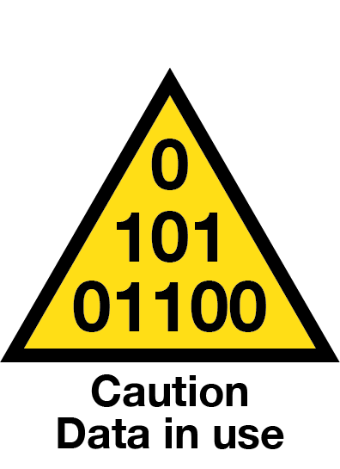
What is Data Safety?
Storing or Accessing data Safely/Securely
Versus
Preventing Data from Causing Harm
Untrustworthy or inappropriate data used by systems and equipment
  Leads to potentially unsafe outcomes
Data used by AI is growing astronomically
Data needs to be considered as a first-class citizen
Loss of Properties of the data
  Accuracy, Integrity, Timeliness, Availability......

Slide 4







All Kinds of Data
Pathology
Sensor data
digital monitoring
Communication data
data flows
telemetry
prescriptions
Map data
patient location
ambulance navigation
Configuration data medical equipment
Dynamic (live) data
versus
Recorded history data

Slide 5
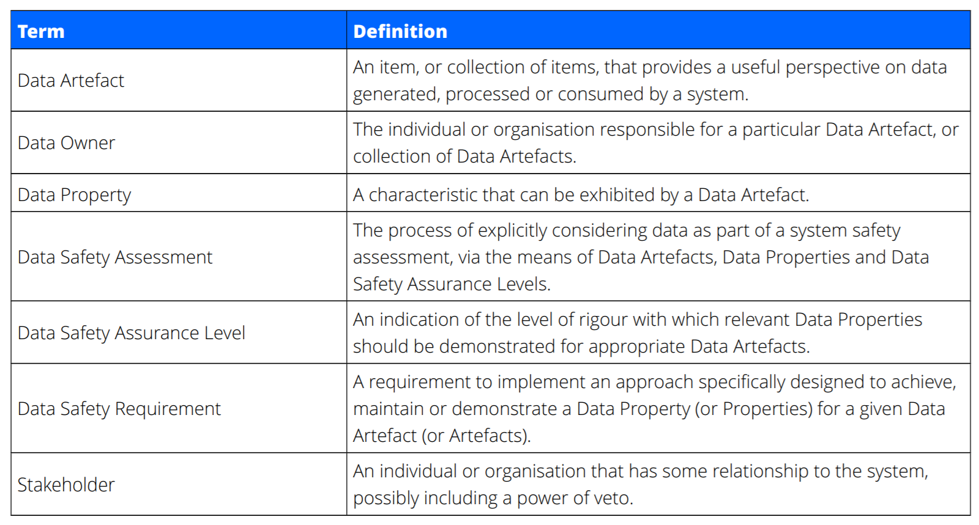
Definitions

Slide 6






Analysis Framework and Process
Organisational
System-level
Data Safety Management Process:
Goal: Derive Data safety requirements
Determine effective mitigations for risks associated with the use of data
4.
Evaluate and Treat Risks
1.
Establish Context
2.
Identify Risks
3.
Analyse Risks

Slide 7
Establish Context
Who are the stakeholders?
Organisation
  Organisational Data Risk (ODR)
  Data Safety Culture
System
  Producers and Consumers of Data
  Data Supply Chains
What are the Data Artefacts of interest?
What interfaces does the system have?
Output: Data Safety Management Plan
Establish

Slide 8
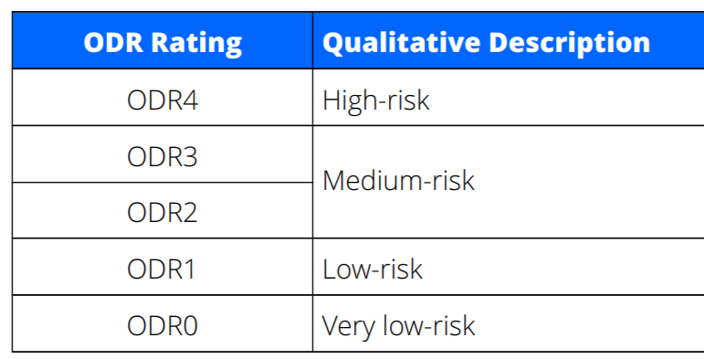

Organisational Data Risk Assessment - ODR
From the perspective of ONE organisation
Completed for each instance, scope, project...
Used in early phases of procurement or project definition
Establish
Quantitative
Qualitative
  Q1 – Severity and Proximity
  Q2 – Organisational and Societal Impact
  Q3 – Responsibility
  Q4 – Legal and Regulatory Framework
  Q5 – Organisational Maturity
  Q6 – Ownership and Usage
  Q7 – Size, Complexity and Novelty
  Q8 – Boundaries and Interfaces

Slide 9
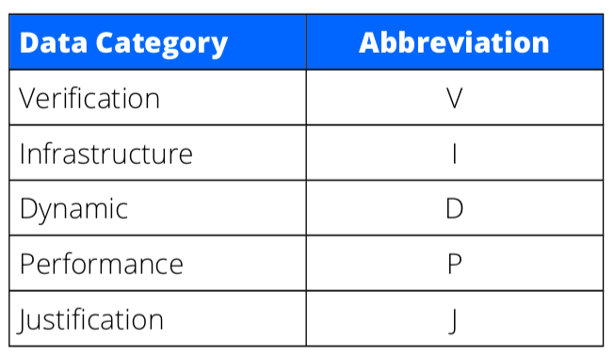
Categories of Data Artefacts
Establish
Examples
A test result
IP address
Blood pressure
A&E wait time
...
Lifecycle stage also determines Data category​
Output of this Phase: List of Data artefacts

Slide 10
Identify Risks
Review relevant historical mishaps
List Risks
  Link to Data Artefacts
  Data category: Lifecycle context
  What properties of the data are lost?
Top-down
  Safety-related functions
    Which Data Artefacts
    What Data Properties
Bottom-up
  Use HAZOP guidewords
Identify

Slide 11
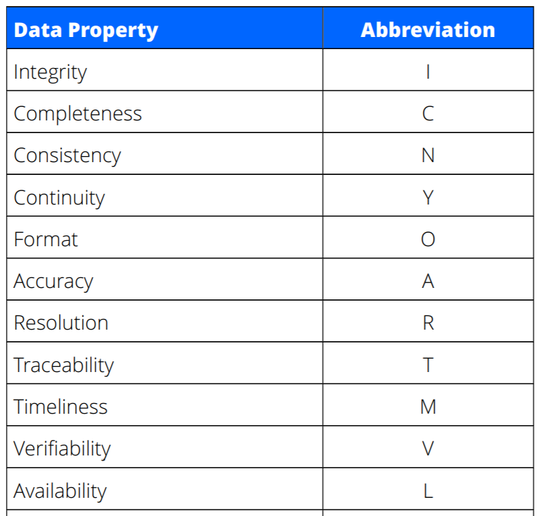
Data Safety Properties
The loss of some of these, can cause risks
Common outcomes may allow grouping one or more properties
Identify

Slide 12
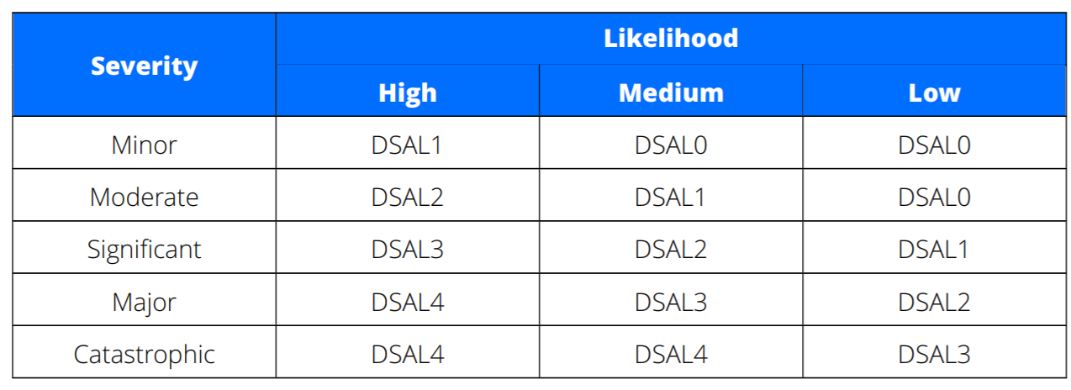
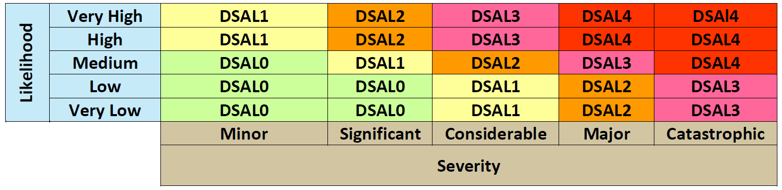
Analyse Risks
Analyse
Justify Analysis
For each risk, establish Data Safety Assurance Level
Mapping into NHS Digital DCB 0160 scheme

Slide 13




Evaluate & Treat Risks
Evaluate
& Treat
Record responses to each risk, with justification
For each risk:
Demonstrate compliance with requirements
  Has risk been suitably mitigated?
  Plan further mitigation, if needed
Add system requirements to treat each risk
Record treatment for each risk,
with evidence of implementation
Avoid
Accept
Transfer
Treat

Slide 14
Treating Risks
Each Data Artefact
  Has a Category
    Dynamic, Verification, ...
  The loss of its Data Safety Properties cause a Risk
    Integrity, Accuracy, Timeliness, Continuity, ...
  The Likelihood and Severity of the Risk imply a DSAL
These define appropriate mitigation techniques
  They can be Recommended (R)
  Or Highly Recommended (HR)
Evaluate
& Treat

Slide 15
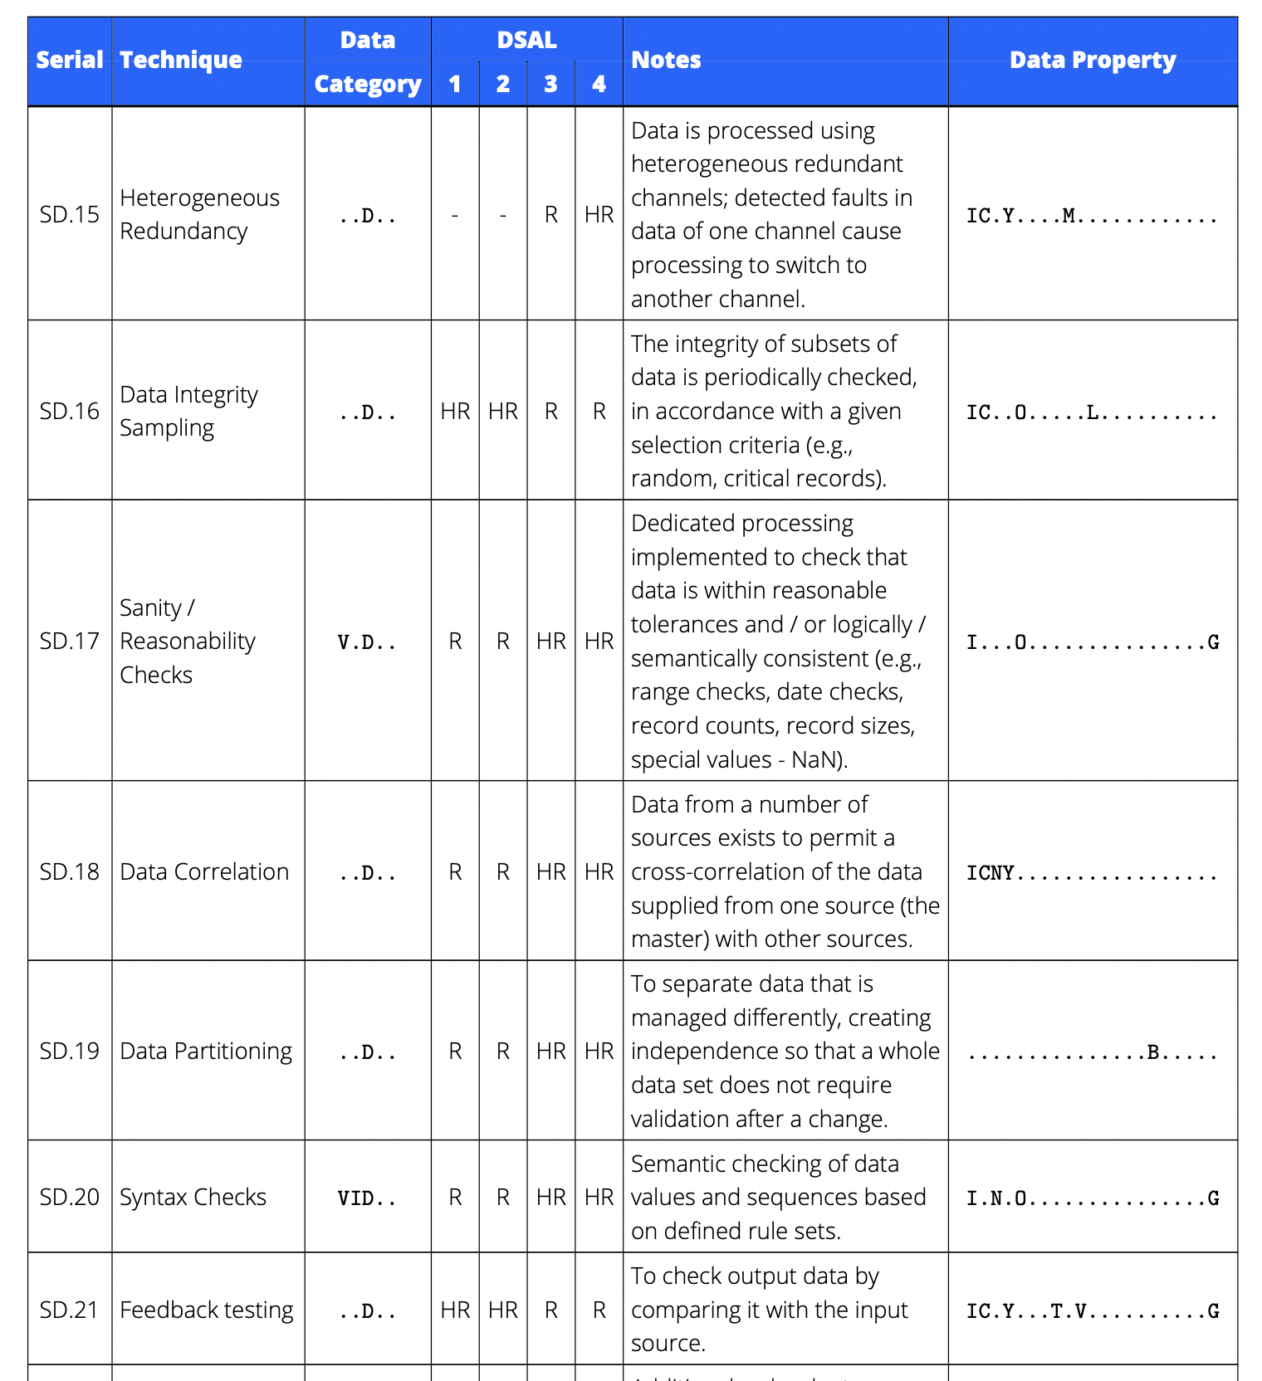
Mitigation Techniques
Evaluate
& Treat
100+ mitigation techniques available
Complex: Needs tool support!

Slide 16
Recap
Data is important, and needs careful management
A rigorous data safety analysis will result in safer outcomes
Best practice guidance is available and should be part of risk management
Organisational
System-level
Data Safety Management Process:
1.
Establish Context
2.
Identify Risks
3.
Analyse Risks
4.
Evaluate and Treat Risks

Slide 17
Visit
data-safety.tech
For
Link to DSIWG Guidance
Searchable Accidents database
Additional Resources
Registration and login for RADISH tool
www.mca-ltd.com

